Slide 1

Ad Captandum: The Efficacy of Information Operations on Electoral Interference
Kevin Zhang New York University Zhang.kevin@nyu.edu

Slide 2


Slide 3
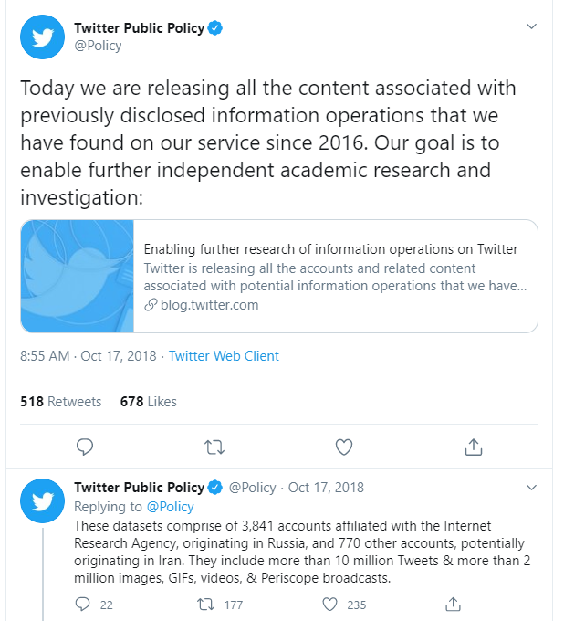
Introduction/Background
In aftermath of the 2020 election, it was concluded that Russia had definitively influenced US voters through a strategy built by “disinformation and social media campaigns by the Internet Research Agency to cause social discord” [1].
As such, many social media companies were used(contrary to their design) as vectors for external countries to exert their foreign policy on the United States.
We seek to examine these foreign information operations in detail.

Slide 4
Methodology
Approach
What strategies exist?
Are these strategies fruitful? Do they prevent detection?
Dataset
Russia (IRA and Russian accounts)
Iran
China
Demo Example: Iran

Slide 5
Methodology
“Iran (4,779 accounts) The below account sets all originated in Iran, and we believe all are associated with — or directly backed by — the Iranian government. However, the signals and behaviors of each set were individually different. We’ve broken them down accordingly:
Set one (1,666 accounts): We removed more than 1,600 accounts originating in Iran. Cumulatively, these accounts Tweeted nearly 2 million times. They Tweeted global news content, often with an angle that benefited the diplomatic and geostrategic views of the Iranian state. Platform manipulation is a violation of the Twitter Rules.
Set two (248 accounts): In addition to the 1,600 accounts listed above, we took action on a second set of more than 200 accounts originating in Iran which were more directly engaged with discussions related to Israel specifically.
Set three (2,865 accounts): Recently, we discussed an action to remove more than 2,800 accounts originating in Iran. These accounts employed a range of false personas to target conversations about political and social issues in Iran and globally.”
“

Slide 6
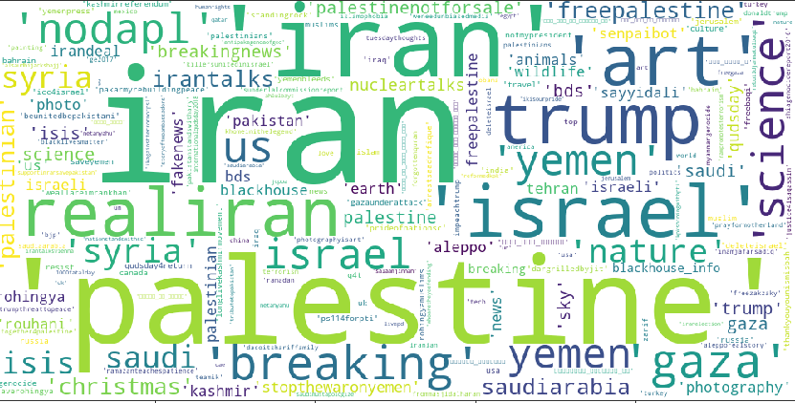
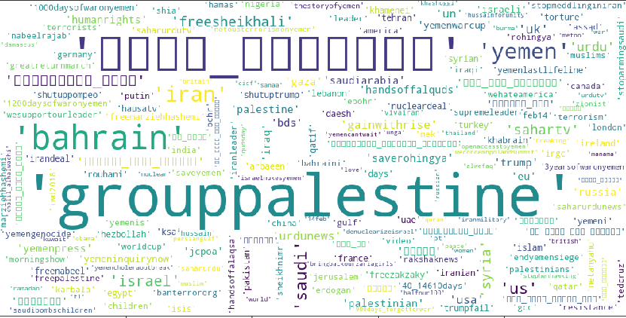
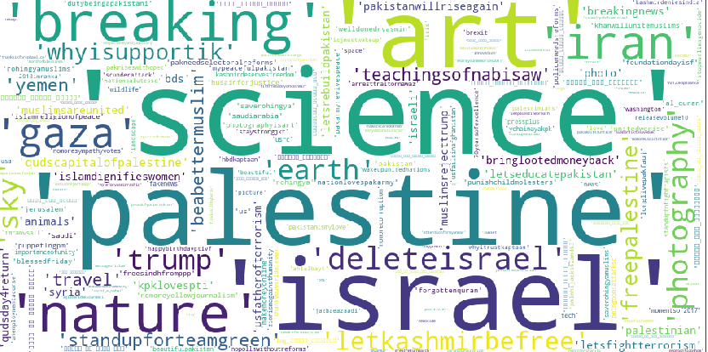
Word Cloud Ex.1

Slide 7
Word Cloud Ex.2

Slide 8
Word Cloud Ex.3

Slide 9
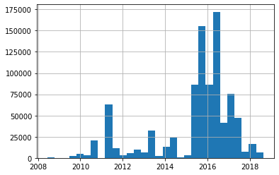
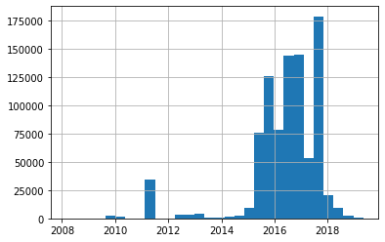
Histograms
First Data Release
Second Data Release
Third Data Release
Number of Followers
Number of Followers
Number of Followers
Year
Year
Year

Slide 10

CONCLUSIONS
What strategies exist?
A) Dormant Accounts
B) Hashtag to maximize followers
C) Geolocation tagging – mismatch with account location source
Are these strategies fruitful? Do they prevent detection?
A) Accounts continue to be created
B) Strategies obfuscate accounts, but do not deter discovery by Twitter
Has this strategy changed over time?
A) Yes – exemplary in Iran’s ethnolinguistic shift (see Word Cloud 3)

Slide 11
Cited Images/Quotes
[1] T. (2018, October 17). Today we are releasing all the content associated with previously disclosed information operations that we have found on our service since 2016. Our goal is to enable further independent academic research and investigation: Https://t.co/rBJNiCjjif. Retrieved May 1, 2020, from https://twitter.com/Policy/status/1052543582199050240
[2] “Fake News Image” Con.healy@symmetricaldatasecurity.com. (2019, December 26). Twitter shuts down Saudi state-backed information operations. Retrieved April 27, 2020, from http://symmetricaldatasecurity.blogspot.com/2019/12/twitter- shuts-down-saudi-state-backed.html
[3] Twitter Safety Video - Twitter Safety. (2020, February 04). We know that some Tweets include manipulated photos or videos that can cause people harm. Today we're introducing a new rule and a label that will address this and give people more context around these Tweets pic.twitter.com/P1ThCsirZ4. Retrieved April 26, 2020, from https://twitter.com/TwitterSafety/status/1224799838895607809
[4] “Twitter Bird Arrow” - Huff, E. (2018, July 27). Twitter caught committing massive election fraud. Retrieved April 30, 2020, from https://www.investmentwatchblog.com/twitter-caught-committing-massive-election-fraud-conservative-voices- shadow-banned-liberal-voices-up-ranked-during-critical-election-year/
[5] Roth, Y. (2019, June 13). Information operations on Twitter: Principles, process, and disclosure. Retrieved May 1, 2020, from https://blog.twitter.com/en_us/topics/company/2019/information-ops-on-twitter.html

